Slide 1
Wilson At-Home Golf Clubs and Virtual Fittings

Slide 2
Table of Contents
Phase 1:
The Problem…………………………..3
Our Research…………………………..4
Key Insights…………………………...5
Our Conclusion and Goals………….6
Phase 2:
Our Plan………………………………...7
Our Criteria…………………………….8
Prototypes……………………………...9
Return Policy………………………..15
Pricings………………………………..18
End:
Our Team……………………………..19
Bibliography………………………….20

Slide 3
The Problem
PHASE ONE
Finding a virtual and remote approach for the process of undergoing a custom golf club fitting.

Slide 4
Our Research Tells Us...
Golf is becoming popular amongst players of all ages.
Since Covid hit, there has been an increase of 23% of players between the ages of 17-21 and an increase of 34% of players between the ages of 22-26.
It is quite common for custom golf fittings to be in person.
We would need static and dynamic characteristics to find the best club.
Wrist to Floor Height, Height, and optional questions that will help with further our research.
Top spin when they hit, total distance traveled, max height, and initial velocity.

Slide 5
Insights
Beginner golfers and experienced golfers may have different preferences based on their level of experience.
Different methods to be used for the simulation of the in-store experience to virtual/online.
Trying to have professional staff on chat to improve golfers guidance.
To make a AI chat-bot which can help customers browse through and act as a sales associate.
According to our research, the “customization” on Wilson’s website for golf specifically is poor compared to their other products.
The aspects of the golf club that will be individually customized are: Club head size, Shaft flex, shaft weight, shaft material, length of the club, lie angle, and grip size.
Need a virtual way to analyze the dynamic attributes of the customers golf swing.
Need to measure clubhead speed, ball speed, launch angle, spin rate, carry distance, and overall distance.
Finding either a hands-on or survey method to help the customizing process.
The target audience. Data shows that due to covid a lot more golfers of all ages are hitting the course.
Cosmetic customizations don’t seem to be very prevalent in the golf fitting process.
According to research conducted at the PGA Tour Superstore, there are not too many Wilson products or options available compared to other golf brands. (Scarce availability)
The fitting experience at PGA Tour Superstore seemed extremely advanced, so the potential for making the experience virtual for golfers will be a lot more technical than originally expected.
Other golf companies allowed their consumers the option to purchase a “golf-club/fitting starter pack,” featuring 3-5 golf clubs that will help determine what works best for them, and also gave them the opportunity to share feedback and adjust their clubs based on the information they provide to the company.

Slide 6
Our Conclusion and Goals
By conducting a website and the use of a demo kits with an attached sensor, we can narrow down the best suited clubs for a beginner/intermediate golfer.

Slide 7
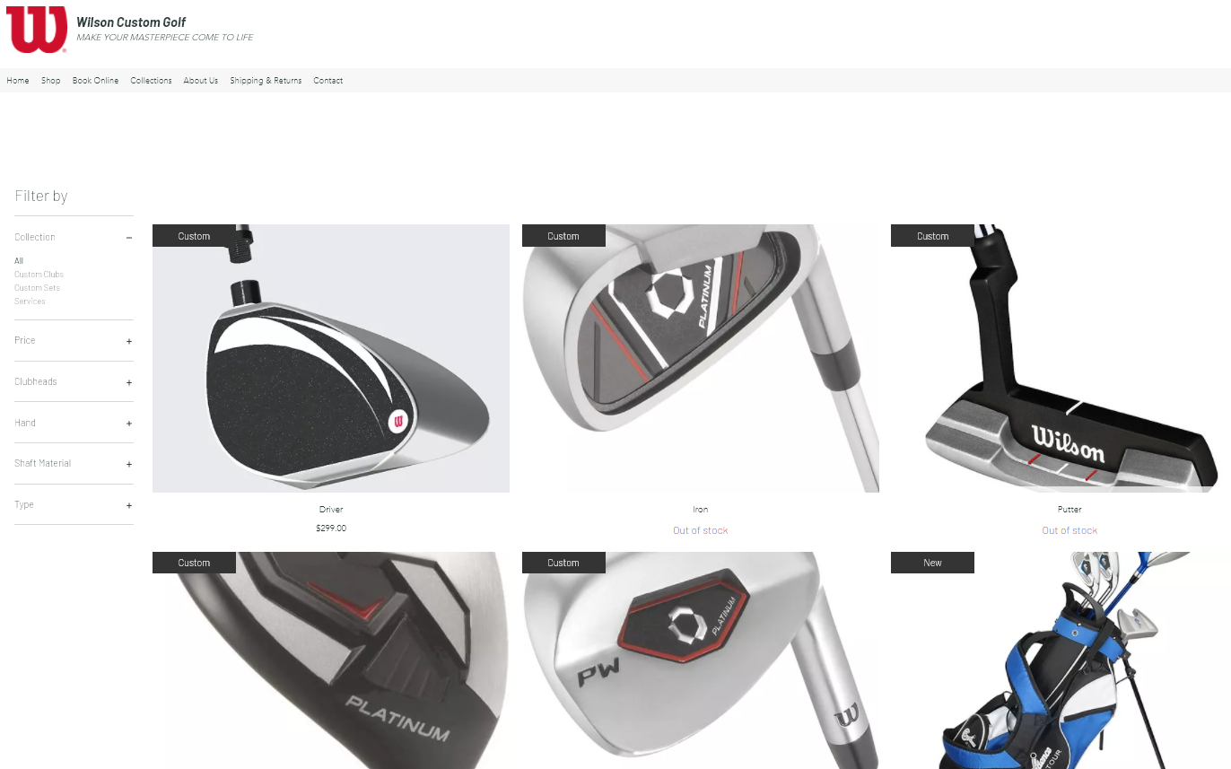
Our Plan
Website
Narrow down the shaft material, grip size, and club head angle to determine the demo kit.
From the demo kit, the following options are available:
Expert consultation
Clubs with different angled clubheads
Attachable sensor
You may select more than one option

Slide 8
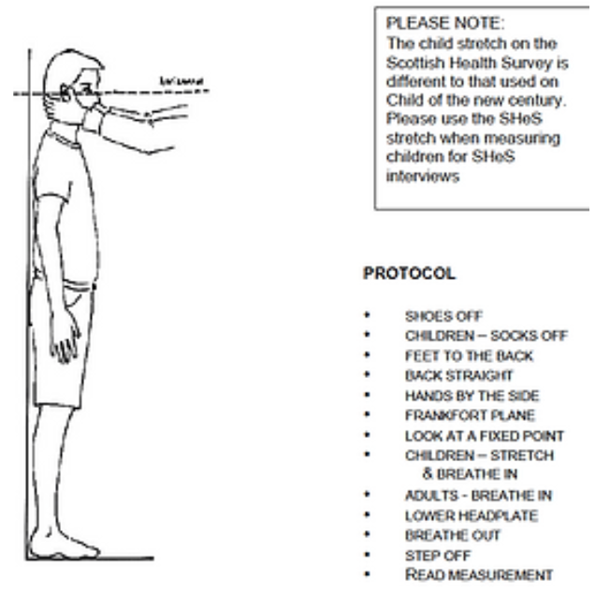
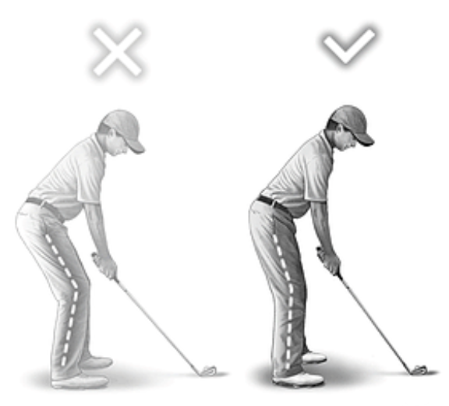
Criteria
Right out of the gate, we can acquire static variables. With the Height of the customer and the wrist to floor height.
We have optional questions that not all golfers will know, but those that do, will get a more specific detail. Such as: which flex they prefer, their price range, etc.
Send out the initial demo kits based on the results from the survey. With the kits that we sent out, attached will be a sensor to determine various ball flight and club delivery aspects that will provide further insight on the best choice of clubs for our customer.
We will have return policies set up for the demo kit and any extra materials used. Based on the information received from the sensor (The spin rate, ball trajectory, total distance traveled, and initial velocity), we can decide how to adjust the golf clubs even further.

Slide 9
Prototyping
Conduct our Initial Survey
Develop Our Website
Create Our Questionnaire
Assemble a Demo Kit

Slide 10
Step 1: Initial Survey
What will the survey collect?
Static Characteristics
Their height (in) and wrist to floor height (in) to determine the length of their club.
Experience Level
We will have optional questions that will lean on their preference. This could help narrow down their preferred type of material and shaft flux.
Price Range
Golf clubs are expensive. Giving us a price range right from the start already gives us the amount of work that we have to do.

Slide 11
Step 2: Website Run Through
The website will give you a list of options to choose from. From various bundles to an expertise consultation:
List of options from the website:
Prototype kits. Our options range from testing/customizing one club to a full set.
Sensors attached to your clubs to give you results from an actual 18 hole course.
Our own launch monitor. Try the Prototype Kits out at home with an option of sensors and/or;
Expertise Consultation. Meet with a Golf Pro over a zoom meeting to discuss different habits within your golf game.

Slide 12
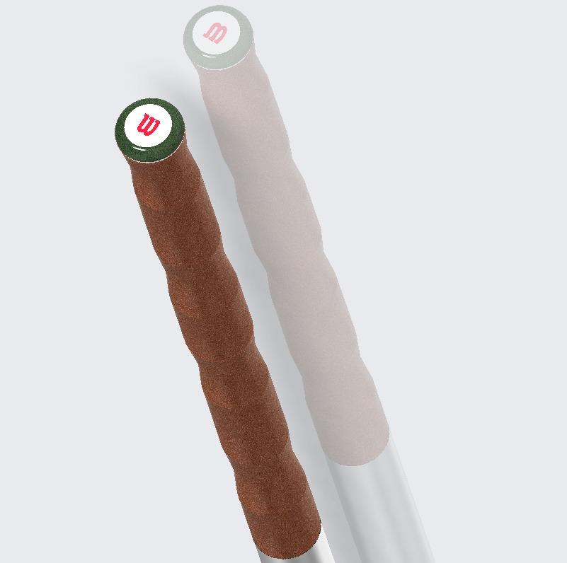
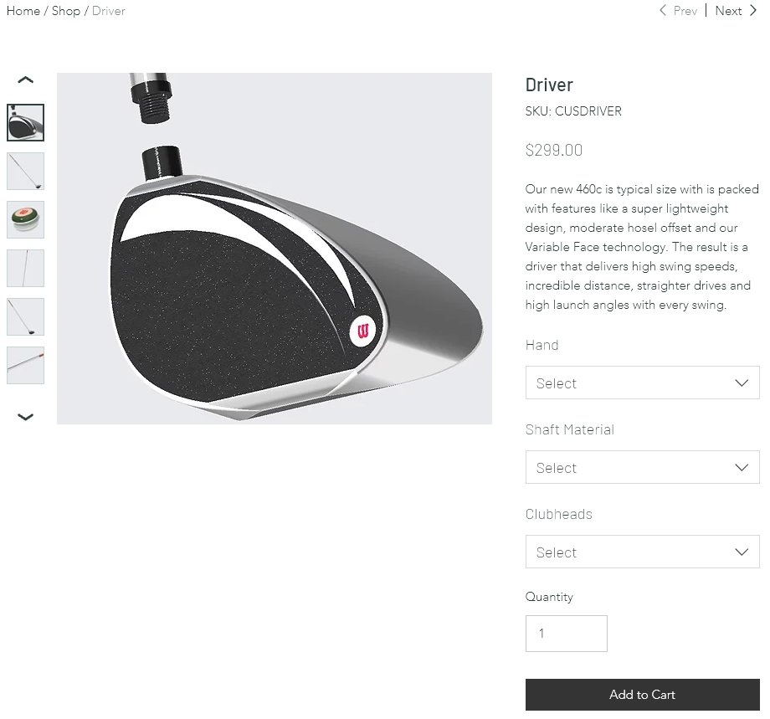
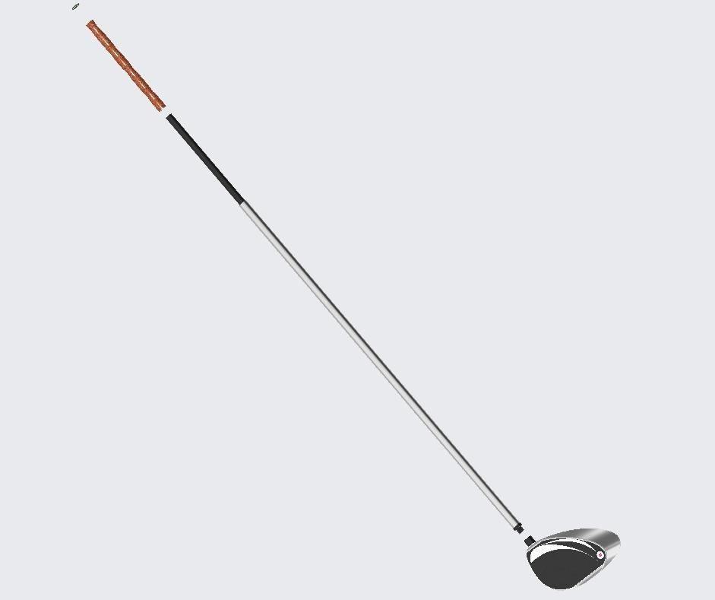
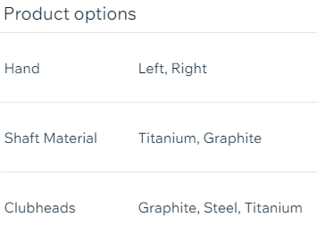
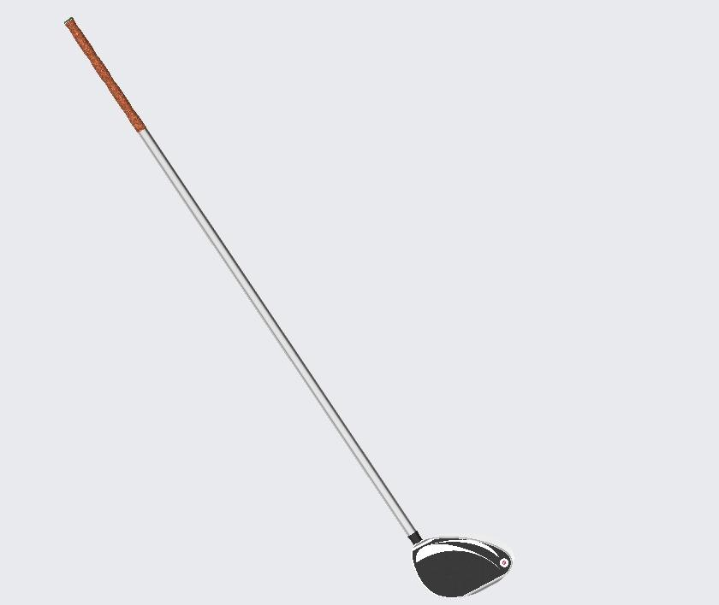
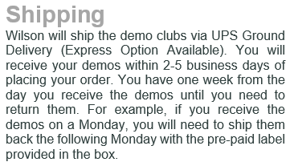

Slide 13
Step 3: Prototype Kits
Based on the results from the survey and the route taken from the website, a Demo kit will be assembled.
The Prototype Kits will include:
“X” Number of clubs (X = number of clubs chosen from website)
3 clubs of different angled clubheads (Closed Face, Square Face, and Open Face)
Shaft in one material (Graphite).
An attachable sensor will be provided in the kit.

Slide 14
Step 4: Purpose of the Sensors
Each club will have a sensor attached. The purpose of the sensors is to help us gather the dynamic characteristics of the customer.
The information that the sensor gives us:
Swing Speed & Total Distance Traveled.
These variables are used to determine the right flex and grip style.
Launch Angle, Swing Speed, Swing Path and Face Angle
These variables will be used to decide the correct weight, balance point and preferred choice of material used.

Slide 15
Step 5: Return Policy and Results
The results will be sent in over a zip file from the sensors. From there we can use the data from the customer’s static and dynamic characteristics to further specify their custom golf clubs.
We will have return policies for the Prototype Kits. To ensure we get all of our belongings back, the clubs fitting process will begin after everything has been returned to us.
The process of constructing the clubs will be 2-4 weeks including delivery time. +/- a week due to back orders or lead times.

Slide 16
Return Policy (continued)
Wilson will ship the demo clubs via UPS Ground Delivery (Express Option Available). You will receive your demos within 2-5 business days of placing your order. After receiving your demo club(s), you will have 1 week to return. We will provide you the prepaid shipping label for your convenience.
To return your demo, put them back in the original box with the return address label inside, and drop it off at any UPS location (Go to UPS.com to find a location near you). DO NOT leave the box outside an unmanned dropbox or with any carrier other than UPS. If you have questions, please contact Wilson’s Customer Service department.

Slide 17
Return Policy (continued)
“What if I don’t return them on time?”
In order for all customers to benefit from this feature and have a chance to demo our clubs, it is important that they are returned to us on time. You will receive a reminder email prior to the return date. If the clubs are shipped back late, you will be charged $15.00 per club, per day that it is late.
If we are unable to reach you after 7 days late, your account will be charged the full retail price for each club. No exceptions. For more information regarding our return policies, please contact Wilson’s Customer Service department.

Slide 18
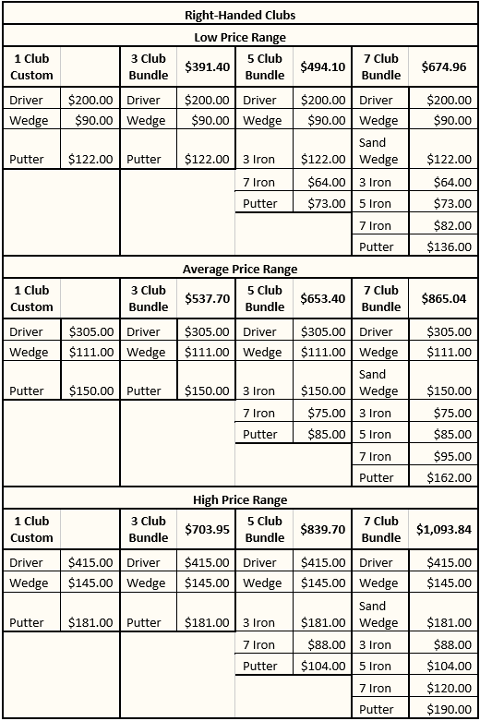
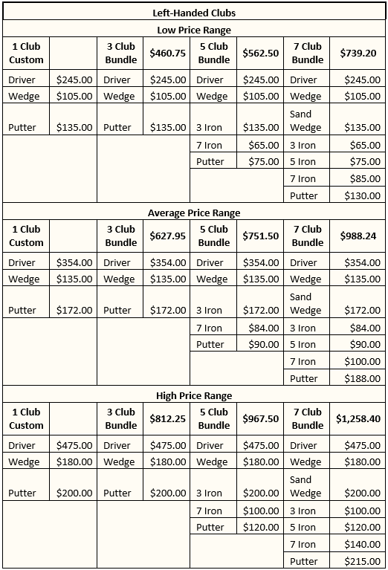
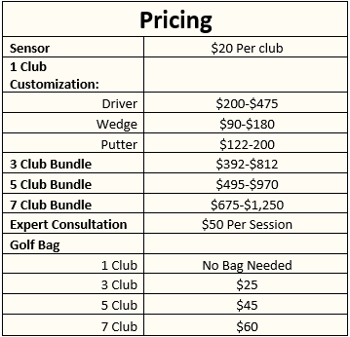
Pricing For the Clubs based on Current Market

Slide 19


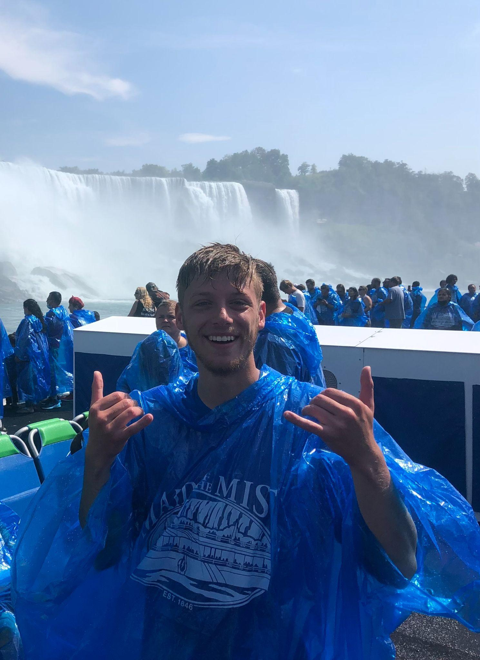


Meet Our Team!
Alan Palayil
Junior in Computer Engineering and Cyber-security
Madelyn Arroyo
Senior in Psychological Science and Human Resources
Jake Westerhoff
Senior in Civil Engineering
Diego Guatemala
Senior in Mechanical Engineering
Yeshwanth Vemula
Junior in Computer Science

Slide 20
Bibliography
https://www.wikihow.com/Fit-Golf-Clubs
https://truespecgolf.com/blog/2018/09/19/what-is-custom-club-fitting/
https://www.golfpass.com/travel-advisor/articles/club-fitting-101-why-you-should-get-fit-and-what-you-need-to-know
https://practical-golf.com/lie-angle/#:~:text=After%20you%20make%20impact%20the,your%20lie%20angle%20is%20correct.
https://www.golfwrx.com/101632/the-most-important-fitting-elements-for-accuracy/

